Slide 1
ALGORITHM INTRODUCTION
2017
Bandung

Slide 2
Mohamad Idham Iskandar – Technical Mentor – .Net, Laravel, Ruby on Rails, & Android Programming

Slide 3
OBJECTIVES
After reading this, the reader should be able to:
Understand the concept of an algorithm.
Define and use the three constructs for developing algorithms: sequence, decision, and repetition.

Slide 4
Is Computer ‘Smart’?
Computer knows nothing, it only follows the designated steps
Example, we ask the computer: Open the Door!
The computer will need to know:
What is a ‘Door’?
Where is the ‘Door’?
How to Open it?
Etc.

Slide 5
To make Computer Works
Provide a computer program so the computer can do our task
To write a computer program, you have to tell the computer, step by step, exactly how you want it to do.
The computer then "executes" the program, following each step mechanically, to accomplish the end goal

Slide 6
To make Computer Works
When you are telling the computer what to do, you also get to choose how it's going to do it
That's where computer algorithms come in

Slide 7
What is Algorithm?
Algorithm is a systematic sequence of steps to solve a particular problem (or specific problem)

Slide 8
Example
what are you going to do if your PC suddenly shut down?
Try to turn it on
If it still doesn’t work.
Check the power input
Try to turn it on again
If it still doesn’t work
Check the hardware
And so on
We can say that those list of actions are the algorithm to fix our PC

Slide 9
More than one Algorithm
For one problem, there might be many algorithms to solve it
Let’s say we are going to go to Surabaya from Bandung, there are many ways to accomplished it
Here are four different algorithms that can be done:

Slide 10

More than one Algorithm
The Train Algorithm:
Go to Hall train station, Bandung
Take the train to Gubeng train station, Surabaya
The Travel Algorithm:
Go to nearest travel company
Take the shuttle travel to Surabaya
The Bus Algorithm:
Go to leuwipanjang bus station, Bandung
Catch a bus to Purabaya bus station, Surabaya
The Plane Algorithm:
Go to Husein Sastranegara Airport, Bandung
Board the plane to Juanda Airport, Surabaya

Slide 11
Choose the best Algorithm
All four of these algorithms accomplish exactly the same goal, but each algorithm does it in completely different way.
Each algorithm also has a different cost and a different travel time.
Taking a plane, for example, is probably the fastest way, but also the most expensive.
Taking the bus is definitely less expensive, but a whole lot slower.
You choose the algorithm based on the circumstances.

Slide 12
Three constructs
Sequence
Decision
Repetition

Slide 13
Flow of action
From the example, we can see that there is a particular flow or sequence of action that we do to solve our problem
We can draw those flow of action into a diagram that we call Flow Chart

Slide 14
Flow Chart
A flowchart is a type of diagram that represents an algorithm or process, showing the steps as boxes of various kinds, and their order by connecting them with arrows

Slide 15
Basic Flow Chart Component
Start / Stop
Process
Input/Output
Conditional
Flow Process

Slide 16
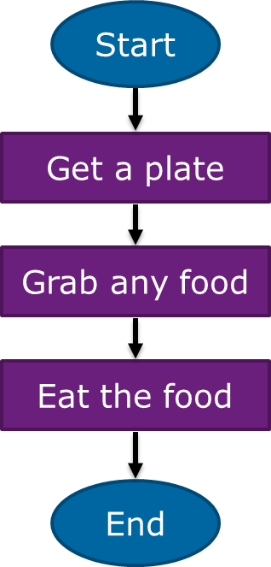
A process flow
I’m Hungry! I want to eat!

Slide 17
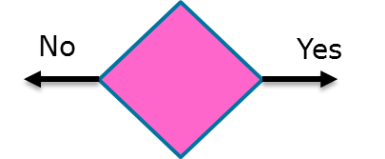
Branch and Condition
We often meet a condition where we must choose what to do from the available option
In flow chart, condition or branch is represented by diamond
on the diamond, we define the choice of condition that must be met

Slide 18
Branch and Condition
If the condition is satisfied then do something, if not then do another thing
If I’m hungry I’ll eat something
If the weather is sunny, I’m going to hang out with my friends, but if it’s rain then I’ll just sleep
On weekday I wore a white shirt, on Friday I wore batik, and on Saturday I wore casual shirt

Slide 19
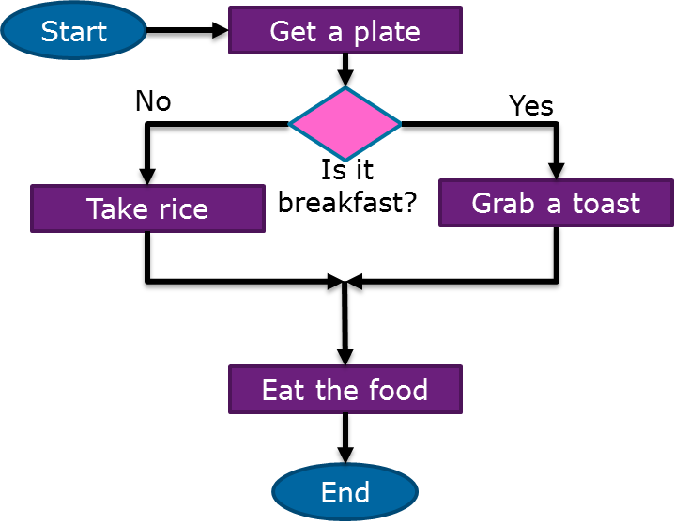
Branch and Condition
I eat French toast for breakfast, otherwise I’ll have rice

Slide 20
Loop and Repetition
Often we also meet a condition where we need to repeat a particular action several times
To write each action separately is wasting

Slide 21
Loop and Repetition
Repeat Doing something until some stopping condition met
I want to eat until I can’t eat anymore
Scrub the car until it’s shining sparkly
While this is still before 5 pm, I’ll continue to sleep

Slide 22
Loop and Repetition
There should be a condition that causes and stop a looping
The loop flow is indicated by an arrow that points back to previous process

Slide 23
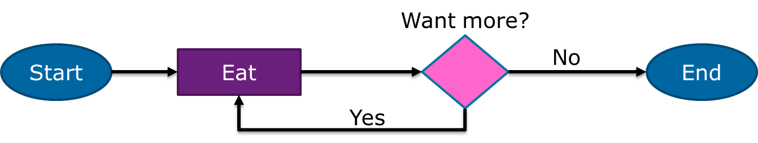
Loop and Repetition
I want to eat until I can’t eat anymore

Slide 24
Programming as Problem Solving
Problem solving principles:
Completely understand the problem
Devise a plan to solve it
Carry out the plan
Review the results
Developing a Program:
Analyze the problem
Design the program
Code the program
Test the program

Slide 25
Analyze the Problem
The problem: Mr Armin wants to invest money at a local bank. There are many options such as interest rates, terms of deposit, compounding frequencies. He needs a program to compute, for any given initial investment, the final maturity (value) of the deposit.
What are the inputs? (given data)
What are the outputs? (required data)
How will we calculate the required outputs from the given inputs?

Slide 26
Design the Program
Create an outline of the program
An algorithm – a step by step procedure that will provide the required results from the given inputs.
Algorithm Examples: Instructions on how to make a cake, use the bank’s ATM, etc.

Slide 27
Code the Program
Once the design is completed, write the program code.
Code is written in some programming language such as BASIC, Pascal, C++, Java, etc. In this course we write code in pseudo-code, developing the skills to be used when studying the specific languages.

Slide 28
Testing the program
Locate any errors (bugs)
Testing is done throughout the development cycle
Desk-checking, or code walkthrough is performed to locate errors in the code.
Pretend you are the computer and execute your own code.
Ultimate test is to run the program to see if the outputs are correct for the given inputs.

Slide 29
Thank You & See You Next Time
Have a nice day
Contact us
Geeksfarm
 JL. Surya Sumantri No. 63, DIGI Building Lt. 3, Bandung 40164.
 022-2027-0501
 0812-2084-4631

